Slide 1
Machine Learning Algorithms
Ada Boost with Logistic Regression
Decision Tree
Logistic Regression
Gaussian Naïve Bayesian
Random Forest

Slide 2
Ada Boost with Logistic Regression – Borderline SMOTE
Feature Selection | Class | Accuracy | TPR | FPR | Precision | Recall | F1 Score | MCC | ROC
Correlation based feature selection | Heart Attack = 1 | 0.943644361 | 0.998132171 | 0.001867829 | 0.945299146 | 0.998132171 | 0.970997406 | 0.01382565 | 0.512735356
 | Heart Attack = 2 | 0.943644361 | 0.004583292 | 0.995416708 | 0.125296482 | 0.004583292 | 0.008839774 | 0.01382565 | 0.512735356
 | Weighted | 0.943644361 | 0.943644361 | 0.056355639 | 0.900326299 | 0.943644361 | 0.918231565 | 0.01382565 | 0.512735356
F Score feature selection | Heart Attack = 1 | 0.941989438 | 0.996269284 | 0.003730716 | 0.945303092 | 0.996269284 | 0.970117092 | 0.010193589 | 0.57751485
 | Heart Attack = 2 | 0.941989438 | 0.006521094 | 0.993478906 | 0.091946692 | 0.006521094 | 0.012177457 | 0.010193589 | 0.57751485
 | Weighted | 0.941989438 | 0.941989438 | 0.058010562 | 0.898502344 | 0.941989438 | 0.917581872 | 0.010193589 | 0.57751485
Forward Sequential Feature Selection | Heart Attack = 1 | 0.942549905 | 0.996795631 | 0.003204369 | 0.945390942 | 0.996795631 | 0.970411522 | 0.016775978 | 0.653372377
 | Heart Attack = 2 | 0.942549905 | 0.007678544 | 0.992321456 | 0.129027063 | 0.007678544 | 0.014134905 | 0.016775978 | 0.653372377
 | Weighted | 0.942549905 | 0.942549905 | 0.057450095 | 0.900620089 | 0.942549905 | 0.917966984 | 0.016775978 | 0.653372377
Recursive Feature Elimination | Heart Attack = 1 | 0.941318643 | 0.995303511 | 0.004696489 | 0.945487607 | 0.995303511 | 0.969751133 | 0.022000973 | 0.639595686
 | Heart Attack = 2 | 0.941318643 | 0.011036088 | 0.988963912 | 0.144768779 | 0.011036088 | 0.019508946 | 0.022000973 | 0.639595686
 | Weighted | 0.941318643 | 0.941318643 | 0.058681357 | 0.901598677 | 0.941318643 | 0.917631732 | 0.022000973 | 0.639595686
Select from Model | Heart Attack = 1 | 0.910297298 | 0.955370616 | 0.044629384 | 0.950100717 | 0.955370616 | 0.952437056 | 0.090141901 | 0.699211019
 | Heart Attack = 2 | 0.910297298 | 0.133029812 | 0.866970188 | 0.151948227 | 0.133029812 | 0.126473479 | 0.090141901 | 0.699211019
 | Weighted | 0.910297298 | 0.910297298 | 0.089702702 | 0.906328444 | 0.910297298 | 0.907152289 | 0.090141901 | 0.699211019

Slide 3
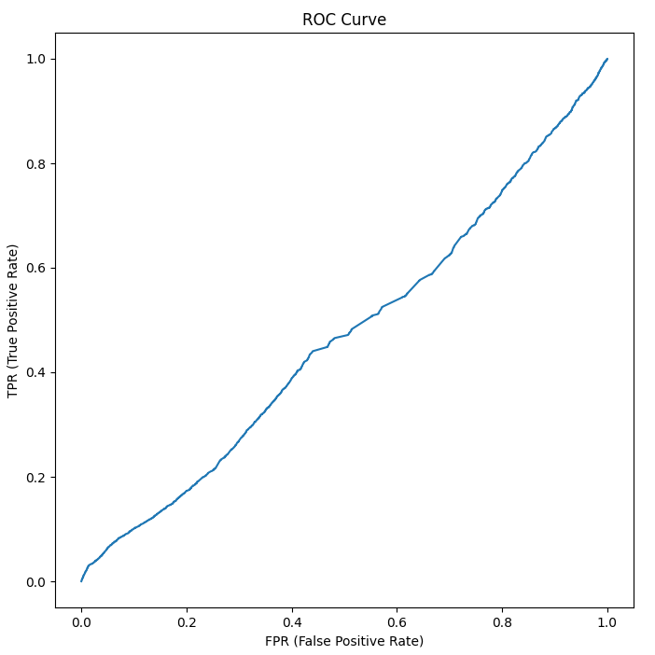
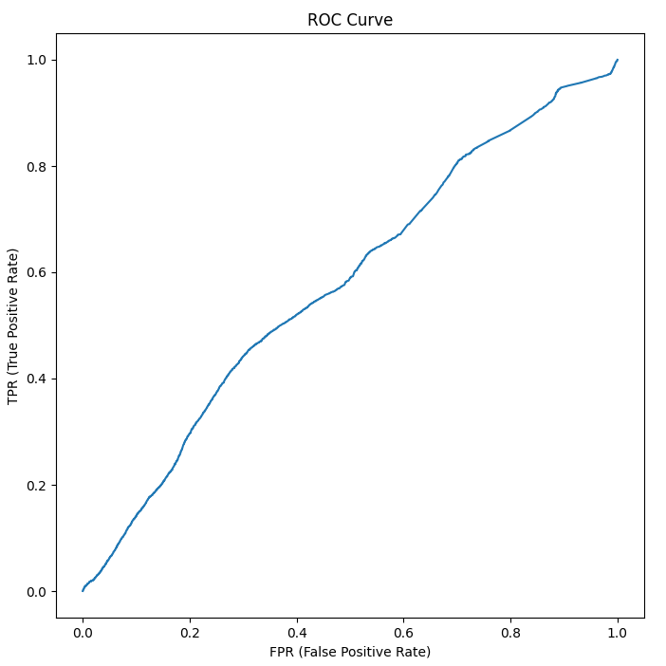
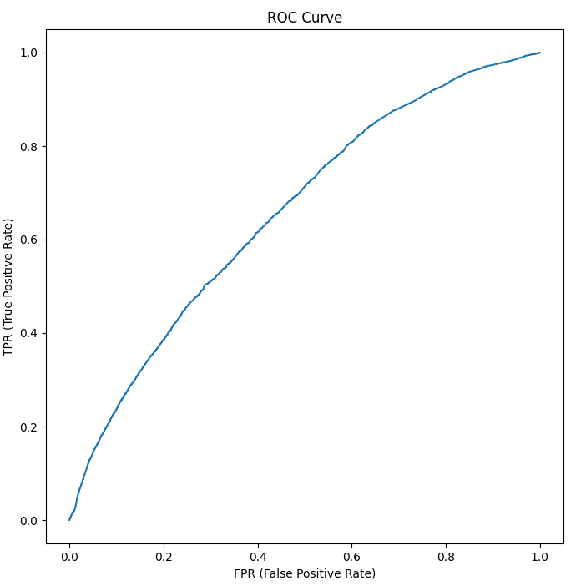
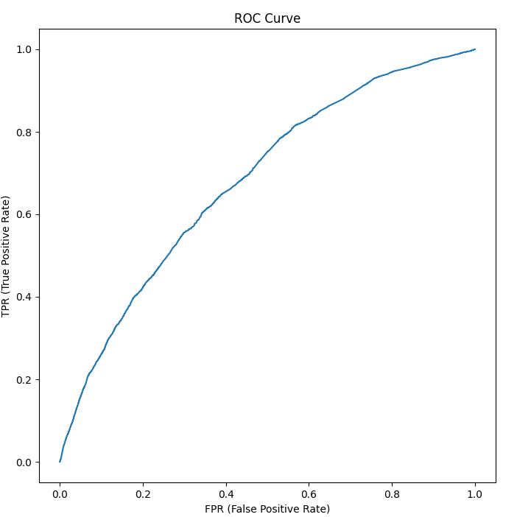
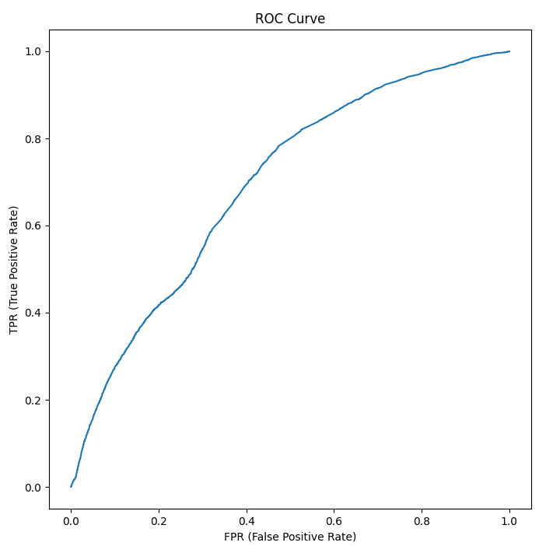
Correlation Based Feature Selection
F Score Feature Selection
Forward Sequential Feature Selection
Recursive Feature Selection
Select from Model Feature Selection

Slide 4
Decision Tree – Borderline SMOTE
Feature Selection | Class | Accuracy | TPR | FPR | Precision | Recall | F1 Score | MCC | ROC
Correlation based feature selection | Heart Attack = 1 | 0.368472617 | 0.348251467 | 0.651748533 | 0.942249441 | 0.348251467 | 0.46053387 | 0.021764693 | 0.530846926
 | Heart Attack = 2 | 0.368472617 | 0.713680245 | 0.286319755 | 0.060409347 | 0.713680245 | 0.110564444 | 0.021764693 | 0.530846926
 | Weighted | 0.368472617 | 0.368472617 | 0.631527383 | 0.893896239 | 0.368472617 | 0.44145991 | 0.021764693 | 0.530846926
F Score feature selection | Heart Attack = 1 | 0.610020742 | 0.627077794 | 0.372922206 | 0.937958858 | 0.627077794 | 0.743691443 | -0.027591147 | 0.470803203
 | Heart Attack = 2 | 0.610020742 | 0.313790602 | 0.686209398 | 0.049192303 | 0.313790602 | 0.084235987 | -0.027591147 | 0.470803203
 | Weighted | 0.610020742 | 0.610020742 | 0.389979258 | 0.889220582 | 0.610020742 | 0.707593075 | -0.027591147 | 0.470803203
Forward Sequential Feature Selection | Heart Attack = 1 | 0.680352756 | 0.704337489 | 0.295662511 | 0.94164905 | 0.704337489 | 0.796269083 | -0.007632153 | 0.486413521
 | Heart Attack = 2 | 0.680352756 | 0.268458523 | 0.731541477 | 0.058852476 | 0.268458523 | 0.090271269 | -0.007632153 | 0.486413521
 | Weighted | 0.680352756 | 0.680352756 | 0.319647244 | 0.89324416 | 0.680352756 | 0.757524885 | -0.007632153 | 0.486413521
Recursive Feature Elimination | Heart Attack = 1 | 0.526452287 | 0.527989715 | 0.472010285 | 0.945780352 | 0.527989715 | 0.667219014 | 0.013359905 | 0.51312783
 | Heart Attack = 2 | 0.526452287 | 0.498337831 | 0.501662169 | 0.060990579 | 0.498337831 | 0.107606474 | 0.013359905 | 0.51312783
 | Weighted | 0.526452287 | 0.526452287 | 0.473547713 | 0.897257369 | 0.526452287 | 0.63658044 | 0.013359905 | 0.51312783
Select from Model | Heart Attack = 1 | 0.640587534 | 0.652842971 | 0.347157029 | 0.951157354 | 0.652842971 | 0.771315026 | 0.041820438 | 0.541617839
 | Heart Attack = 2 | 0.640587534 | 0.430152752 | 0.569847248 | 0.069925432 | 0.430152752 | 0.11964779 | 0.041820438 | 0.541617839
 | Weighted | 0.640587534 | 0.640587534 | 0.359412466 | 0.90282836 | 0.640587534 | 0.73556036 | 0.041820438 | 0.541617839

Slide 5
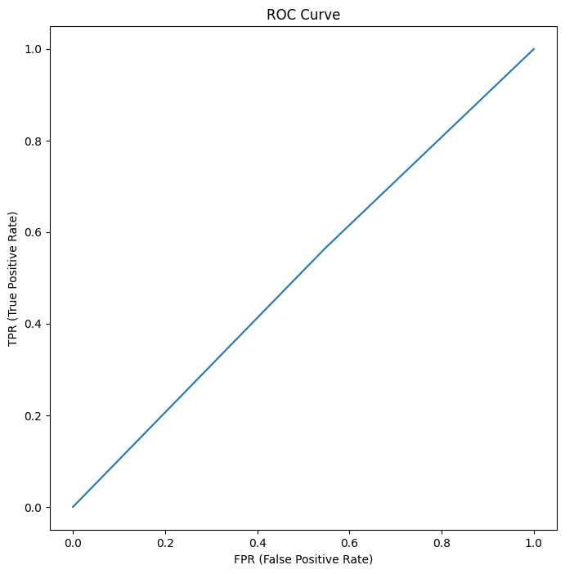
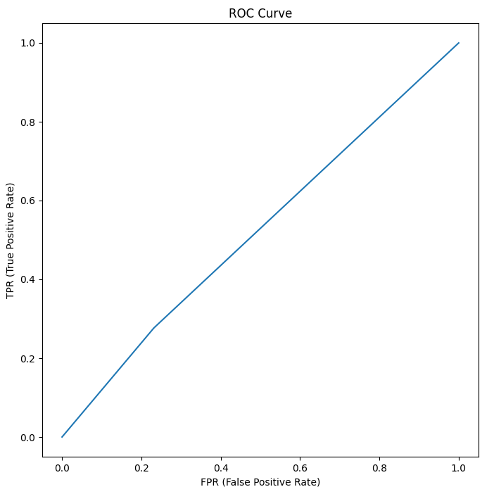
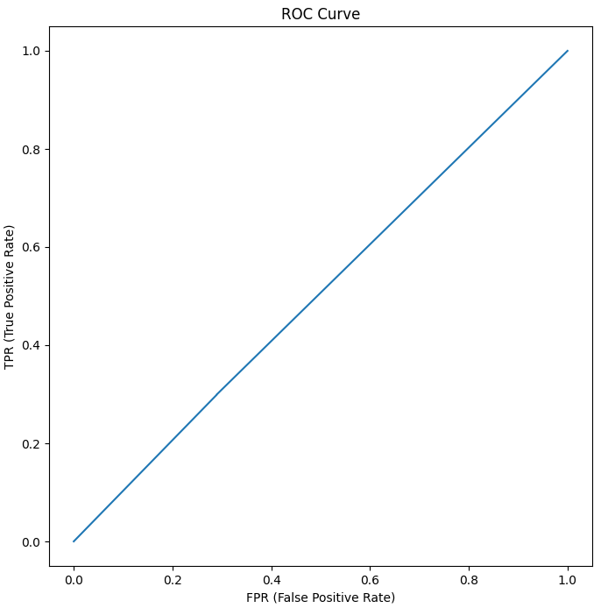
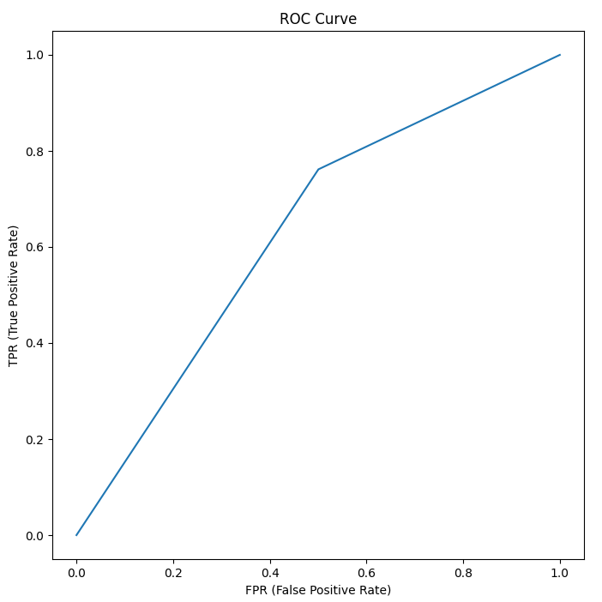
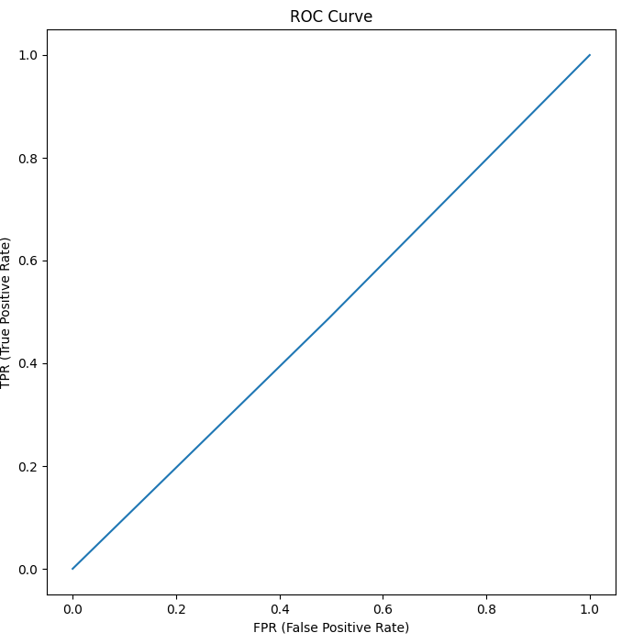
Correlation Based Feature Selection
F Score Feature Selection
Forward Sequential Feature Selection
Recursive Feature Selection
Select from Model Feature Selection

Slide 6
Logistic Regression – Borderline SMOTE
Feature Selection | Class | Accuracy | TPR | FPR | Precision | Recall | F1 Score | MCC | ROC
Correlation based feature selection | Heart Attack = 1 | 0.93962253 | 0.993566294 | 0.006433706 | 0.945339286 | 0.993566294 | 0.968852836 | 0.00945789 | 0.389521608
 | Heart Attack = 2 | 0.93962253 | 0.009889616 | 0.990110384 | 0.080841391 | 0.009889616 | 0.017544069 | 0.00945789 | 0.389521608
 | Weighted | 0.93962253 | 0.93962253 | 0.06037747 | 0.897932099 | 0.93962253 | 0.916685141 | 0.00945789 | 0.389521608
F Score feature selection | Heart Attack = 1 | 0.940818488 | 0.994228711 | 0.005771289 | 0.945917731 | 0.994228711 | 0.969471512 | 0.040896709 | 0.619528511
 | Heart Attack = 2 | 0.940818488 | 0.020331557 | 0.979668443 | 0.169298485 | 0.020331557 | 0.036262895 | 0.040896709 | 0.619528511
 | Weighted | 0.940818488 | 0.940818488 | 0.059181512 | 0.903325357 | 0.940818488 | 0.918292963 | 0.040896709 | 0.619528511
Forward Sequential Feature Selection | Heart Attack = 1 | 0.938725195 | 0.991176266 | 0.008823734 | 0.94651709 | 0.991176266 | 0.968330086 | 0.058188162 | 0.659068422
 | Heart Attack = 2 | 0.938725195 | 0.034735477 | 0.965264523 | 0.186567093 | 0.034735477 | 0.057973982 | 0.058188162 | 0.659068422
 | Weighted | 0.938725195 | 0.938725195 | 0.061274805 | 0.904839791 | 0.938725195 | 0.918406879 | 0.058188162 | 0.659068422
Recursive Feature Elimination | Heart Attack = 1 | 0.938391268 | 0.990967618 | 0.009032382 | 0.946374602 | 0.990967618 | 0.968157631 | 0.052314496 | 0.65337832
 | Heart Attack = 2 | 0.938391268 | 0.032245039 | 0.967754961 | 0.171954622 | 0.032245039 | 0.054204339 | 0.052314496 | 0.65337832
 | Weighted | 0.938391268 | 0.938391268 | 0.061608732 | 0.903903064 | 0.938391268 | 0.918036988 | 0.052314496 | 0.65337832
Select from Model | Heart Attack = 1 | 0.9199238 | 0.96464528 | 0.03535472 | 0.951317313 | 0.96464528 | 0.95792908 | 0.129149269 | 0.731736896
 | Heart Attack = 2 | 0.9199238 | 0.149063378 | 0.850936622 | 0.195817836 | 0.149063378 | 0.168717102 | 0.129149269 | 0.731736896
 | Weighted | 0.9199238 | 0.9199238 | 0.0800762 | 0.909888 | 0.9199238 | 0.914652965 | 0.129149269 | 0.731736896

Slide 7


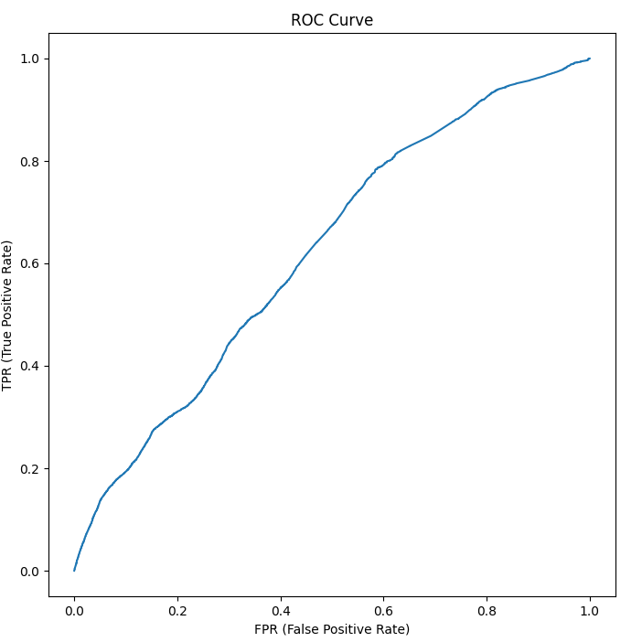
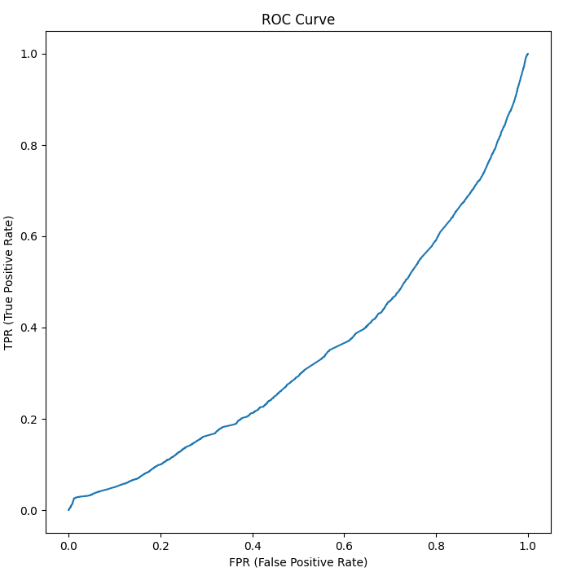
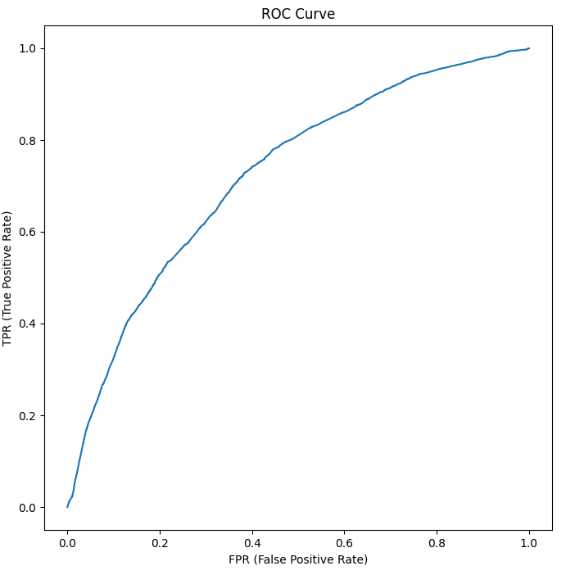
Correlation Based Feature Selection
F Score Feature Selection
Forward Sequential Feature Selection
Recursive Feature Selection
Select from Model Feature Selection

Slide 8
Gaussian Naïve Bayesian – Borderline SMOTE
Feature Selection | Class | Accuracy | TPR | FPR | Precision | Recall | F1 Score | MCC | ROC
Correlation based feature selection | Heart Attack = 1 | 0.51676253 | 0.509793769 | 0.490206231 | 0.963158641 | 0.509793769 | 0.642735997 | 0.069862471 | 0.632093558
 | Heart Attack = 2 | 0.51676253 | 0.631766939 | 0.368233061 | 0.071393146 | 0.631766939 | 0.126100009 | 0.069862471 | 0.632093558
 | Weighted | 0.51676253 | 0.51676253 | 0.48323747 | 0.914243024 | 0.51676253 | 0.614523307 | 0.069862471 | 0.632093558
F Score feature selection | Heart Attack = 1 | 0.935856662 | 0.989450341 | 0.010549659 | 0.945244413 | 0.989450341 | 0.966842238 | 0.00364669 | 0.490675735
 | Heart Attack = 2 | 0.935856662 | 0.012194868 | 0.987805132 | 0.062843518 | 0.012194868 | 0.020416392 | 0.00364669 | 0.490675735
 | Weighted | 0.935856662 | 0.935856662 | 0.064143338 | 0.896853737 | 0.935856662 | 0.914939725 | 0.00364669 | 0.490675735
Forward Sequential Feature Selection | Heart Attack = 1 | 0.937830801 | 0.99161649 | 0.00838351 | 0.945287658 | 0.99161649 | 0.967892173 | 0.005213157 | 0.597317896
 | Heart Attack = 2 | 0.937830801 | 0.010835585 | 0.989164415 | 0.067050468 | 0.010835585 | 0.017908071 | 0.005213157 | 0.597317896
 | Weighted | 0.937830801 | 0.937830801 | 0.062169199 | 0.897127403 | 0.937830801 | 0.915796238 | 0.005213157 | 0.597317896
Recursive Feature Elimination | Heart Attack = 1 | 0.924314862 | 0.97614705 | 0.02385295 | 0.945528203 | 0.97614705 | 0.960575299 | 0.011313978 | 0.596688478
 | Heart Attack = 2 | 0.924314862 | 0.030832348 | 0.969167652 | 0.073616947 | 0.030832348 | 0.042016894 | 0.011313978 | 0.596688478
 | Weighted | 0.924314862 | 0.924314862 | 0.075685138 | 0.897706531 | 0.924314862 | 0.910207336 | 0.011313978 | 0.596688478
Select from Model | Heart Attack = 1 | 0.924314862 | 0.97614705 | 0.02385295 | 0.945528203 | 0.97614705 | 0.960575299 | 0.011313978 | 0.596688478
 | Heart Attack = 2 | 0.924314862 | 0.030832348 | 0.969167652 | 0.073616947 | 0.030832348 | 0.042016894 | 0.011313978 | 0.596688478
 | Weighted | 0.924314862 | 0.924314862 | 0.075685138 | 0.897706531 | 0.924314862 | 0.910207336 | 0.011313978 | 0.596688478

Slide 9
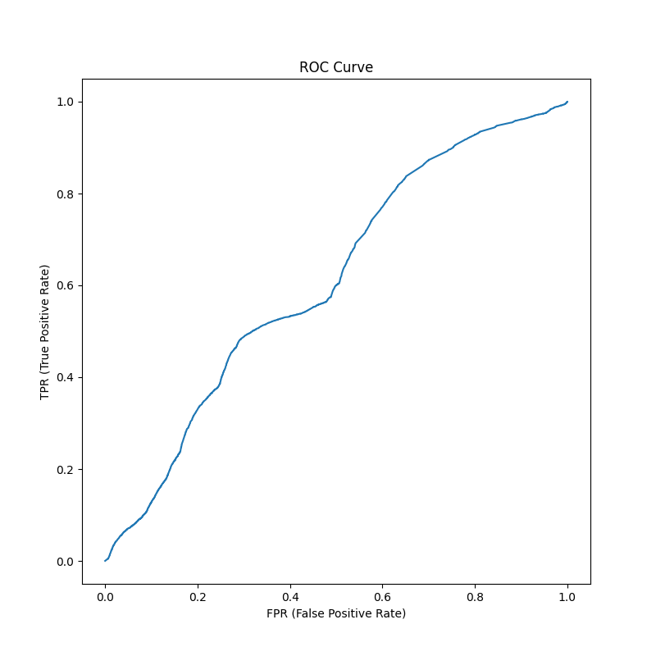
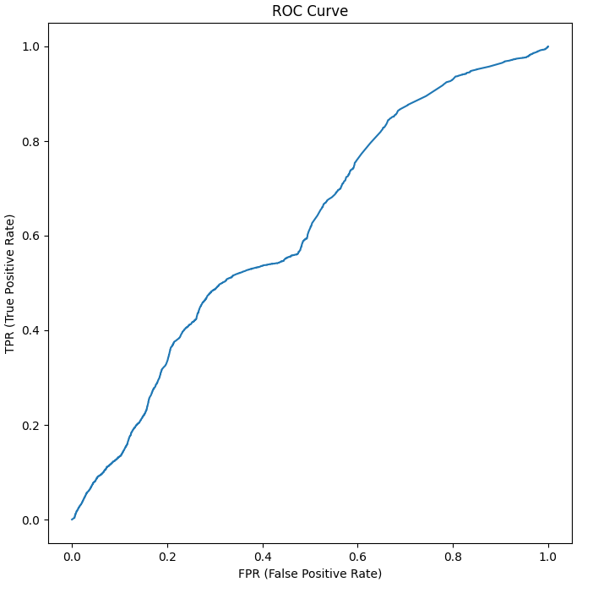
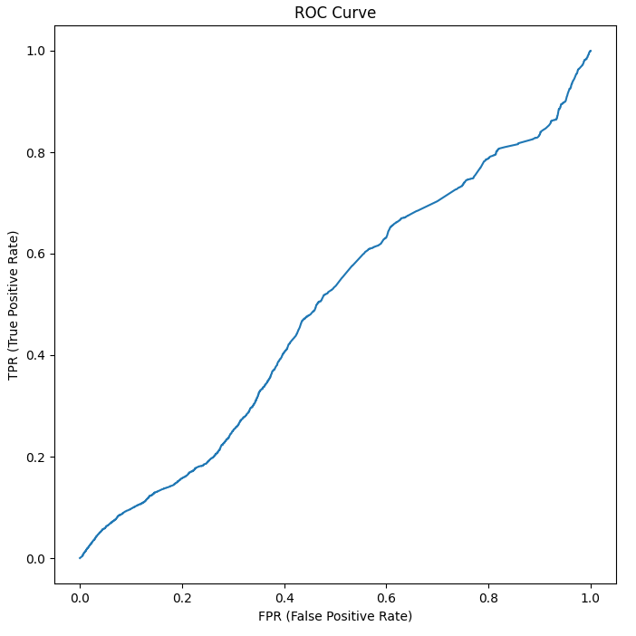
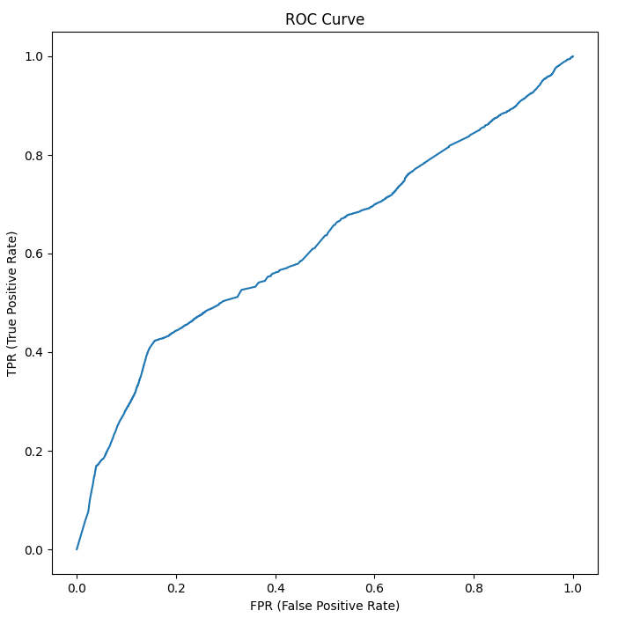
Correlation Based Feature Selection
F Score Feature Selection
Forward Sequential Feature Selection
Recursive Feature Selection
Select from Model Feature Selection

Slide 10
Random Forest – Borderline SMOTE
Feature Selection | Class | Accuracy | TPR | FPR | Precision | Recall | F1 Score | MCC | ROC
Correlation based feature selection | Heart Attack = 1 | 0.797455096 | 0.837469496 | 0.162530504 | 0.94167275 | 0.837469496 | 0.88590295 | -0.034908929 | 0.432081655
 | Heart Attack = 2 | 0.797455096 | 0.106761219 | 0.893238781 | 0.036199842 | 0.106761219 | 0.053260208 | -0.034908929 | 0.432081655
 | Weighted | 0.797455096 | 0.797455096 | 0.202544904 | 0.892018454 | 0.797455096 | 0.840263844 | -0.034908929 | 0.432081655
F Score feature selection | Heart Attack = 1 | 0.845005075 | 0.887896961 | 0.112103039 | 0.94471569 | 0.887896961 | 0.912795619 | -0.004409428 | 0.485727929
 | Heart Attack = 2 | 0.845005075 | 0.105202035 | 0.894797965 | 0.052386576 | 0.105202035 | 0.061438169 | -0.004409428 | 0.485727929
 | Weighted | 0.845005075 | 0.845005075 | 0.154994925 | 0.895782493 | 0.845005075 | 0.866118095 | -0.004409428 | 0.485727929
Forward Sequential Feature Selection | Heart Attack = 1 | 0.836158225 | 0.87502868 | 0.12497132 | 0.94769769 | 0.87502868 | 0.908232402 | 0.029514606 | 0.563582495
 | Heart Attack = 2 | 0.836158225 | 0.166104822 | 0.833895178 | 0.074772597 | 0.166104822 | 0.096205604 | 0.029514606 | 0.563582495
 | Weighted | 0.836158225 | 0.836158225 | 0.163841775 | 0.899831739 | 0.836158225 | 0.863705443 | 0.029514606 | 0.563582495
Recursive Feature Elimination | Heart Attack = 1 | 0.828903044 | 0.867023518 | 0.132976482 | 0.947415603 | 0.867023518 | 0.904710287 | 0.028490227 | 0.563454276
 | Heart Attack = 2 | 0.828903044 | 0.171358739 | 0.828641261 | 0.07418109 | 0.171358739 | 0.100373258 | 0.028490227 | 0.563454276
 | Weighted | 0.828903044 | 0.828903044 | 0.171096956 | 0.899519985 | 0.828903044 | 0.860606181 | 0.028490227 | 0.563454276
Select from Model | Heart Attack = 1 | 0.777178246 | 0.803290358 | 0.196709642 | 0.953902596 | 0.803290358 | 0.871608275 | 0.071393258 | 0.600906931
 | Heart Attack = 2 | 0.777178246 | 0.326892863 | 0.673107137 | 0.085376017 | 0.326892863 | 0.134642127 | 0.071393258 | 0.600906931
 | Weighted | 0.777178246 | 0.777178246 | 0.222821754 | 0.906272322 | 0.777178246 | 0.831197088 | 0.071393258 | 0.600906931

Slide 11
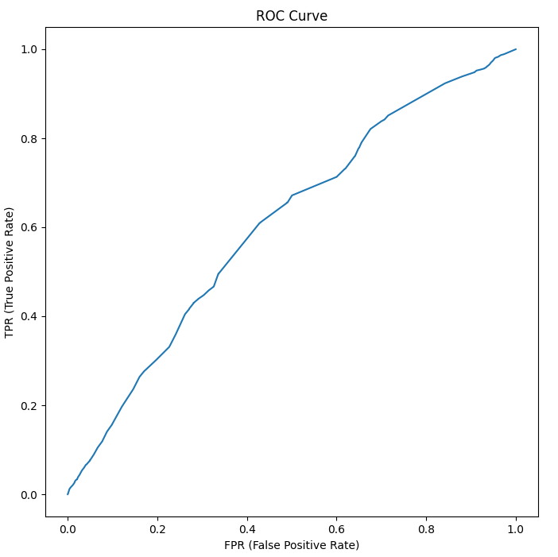
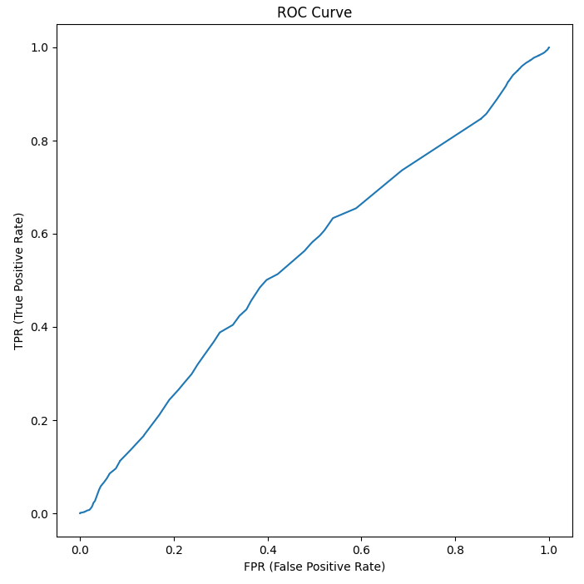
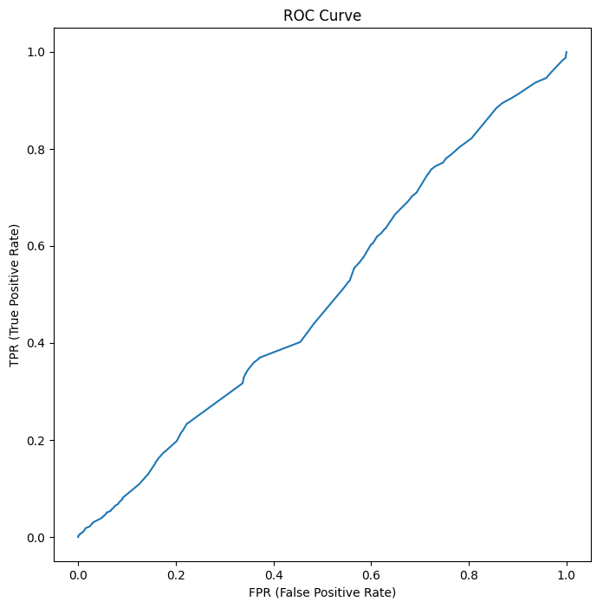
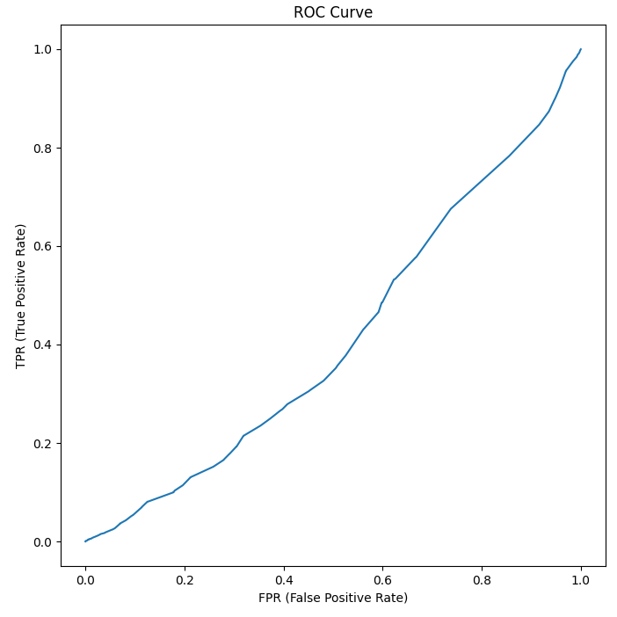
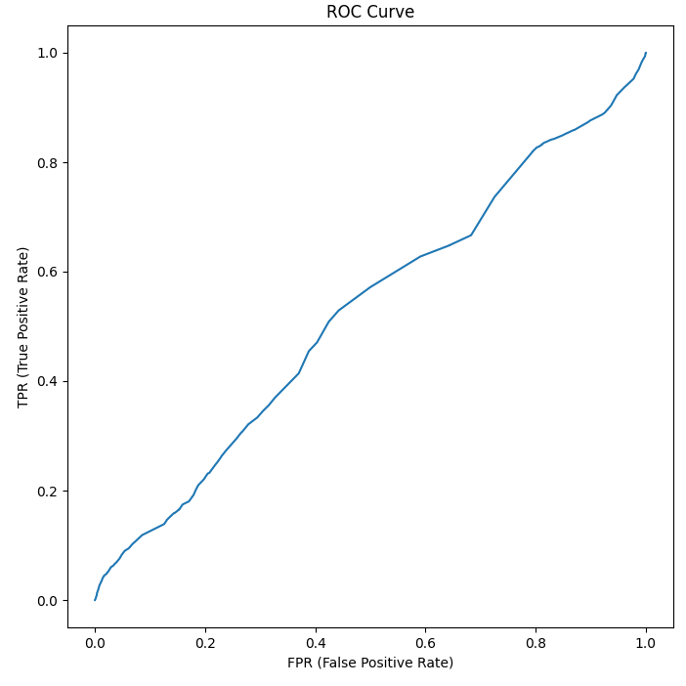
Correlation Based Feature Selection
F Score Feature Selection
Forward Sequential Feature Selection
Recursive Feature Selection
Select from Model Feature Selection

Slide 12
Best Model – Borderline SMOTE
Classifier | Feature Selection | Class | Accuracy | TPR | FPR | Precision | Recall | F1 Score | MCC | ROC
Ada Boost | Recursive Feature Elimination | Heart Attack = 1 | 0.941318643 | 0.995303511 | 0.004696489 | 0.945487607 | 0.995303511 | 0.969751133 | 0.022000973 | 0.639595686
 |  | Heart Attack = 2 | 0.941318643 | 0.011036088 | 0.988963912 | 0.144768779 | 0.011036088 | 0.019508946 | 0.022000973 | 0.639595686
 |  | Weighted | 0.941318643 | 0.941318643 | 0.058681357 | 0.901598677 | 0.941318643 | 0.917631732 | 0.022000973 | 0.639595686
Decision Tree | Select from Model | Heart Attack = 1 | 0.640587534 | 0.652842971 | 0.347157029 | 0.951157354 | 0.652842971 | 0.771315026 | 0.041820438 | 0.541617839
 |  | Heart Attack = 2 | 0.640587534 | 0.430152752 | 0.569847248 | 0.069925432 | 0.430152752 | 0.11964779 | 0.041820438 | 0.541617839
 |  | Weighted | 0.640587534 | 0.640587534 | 0.359412466 | 0.90282836 | 0.640587534 | 0.73556036 | 0.041820438 | 0.541617839
Logistic Regression | Select from Model | Heart Attack = 1 | 0.9199238 | 0.96464528 | 0.03535472 | 0.951317313 | 0.96464528 | 0.95792908 | 0.129149269 | 0.731736896
 |  | Heart Attack = 2 | 0.9199238 | 0.149063378 | 0.850936622 | 0.195817836 | 0.149063378 | 0.168717102 | 0.129149269 | 0.731736896
 |  | Weighted | 0.9199238 | 0.9199238 | 0.0800762 | 0.909888 | 0.9199238 | 0.914652965 | 0.129149269 | 0.731736896
Gaussian Naïve Bayesian | Recursive Feature Elimination | Heart Attack = 1 | 0.924314862 | 0.97614705 | 0.02385295 | 0.945528203 | 0.97614705 | 0.960575299 | 0.011313978 | 0.596688478
 |  | Heart Attack = 2 | 0.924314862 | 0.030832348 | 0.969167652 | 0.073616947 | 0.030832348 | 0.042016894 | 0.011313978 | 0.596688478
 |  | Weighted | 0.924314862 | 0.924314862 | 0.075685138 | 0.897706531 | 0.924314862 | 0.910207336 | 0.011313978 | 0.596688478
Random Forest | Select from Model | Heart Attack = 1 | 0.777178246 | 0.803290358 | 0.196709642 | 0.953902596 | 0.803290358 | 0.871608275 | 0.071393258 | 0.600906931
 |  | Heart Attack = 2 | 0.777178246 | 0.326892863 | 0.673107137 | 0.085376017 | 0.326892863 | 0.134642127 | 0.071393258 | 0.600906931
 |  | Weighted | 0.777178246 | 0.777178246 | 0.222821754 | 0.906272322 | 0.777178246 | 0.831197088 | 0.071393258 | 0.600906931

Slide 13
Ada Boost with Logistic Regression – SMOTE
Feature Selection | Class | Accuracy | TPR | FPR | Precision | Recall | F1 Score | MCC | ROC
Correlation based feature selection | Heart Attack = 1 | 0.943895909 | 0.998404437 | 0.001595563 | 0.94530761 | 0.998404437 | 0.971130645 | 0.015895248 | 0.583381099
 | Heart Attack = 2 | 0.943895909 | 0.004478198 | 0.995521802 | 0.144906683 | 0.004478198 | 0.008656026 | 0.015895248 | 0.583381099
 | Weighted | 0.943895909 | 0.943895909 | 0.056104091 | 0.901396561 | 0.943895909 | 0.918347218 | 0.015895248 | 0.583381099
F Score feature selection | Heart Attack = 1 | 0.941849689 | 0.996071584 | 0.003928416 | 0.945337477 | 0.996071584 | 0.970041476 | 0.012266354 | 0.579878388
 | Heart Attack = 2 | 0.941849689 | 0.007379195 | 0.992620805 | 0.098273264 | 0.007379195 | 0.013726906 | 0.012266354 | 0.579878388
 | Weighted | 0.941849689 | 0.941849689 | 0.058150311 | 0.898881302 | 0.941849689 | 0.917595413 | 0.012266354 | 0.579878388
Forward Sequential Feature Selection | Heart Attack = 1 | 0.942333662 | 0.996614509 | 0.003385491 | 0.945340977 | 0.996614509 | 0.970296033 | 0.01313136 | 0.700430025
 | Heart Attack = 2 | 0.942333662 | 0.006907136 | 0.993092864 | 0.116275926 | 0.006907136 | 0.012183363 | 0.01313136 | 0.700430025
 | Weighted | 0.942333662 | 0.942333662 | 0.057666338 | 0.899878271 | 0.942333662 | 0.917747393 | 0.01313136 | 0.700430025
Recursive Feature Elimination | Heart Attack = 1 | 0.943954751 | 0.998365781 | 0.001634219 | 0.945396378 | 0.998365781 | 0.97115917 | 0.024017229 | 0.631823228
 | Heart Attack = 2 | 0.943954751 | 0.006225691 | 0.993774309 | 0.18033645 | 0.006225691 | 0.012034592 | 0.024017229 | 0.631823228
 | Weighted | 0.943954751 | 0.943954751 | 0.056045249 | 0.903438401 | 0.943954751 | 0.918558979 | 0.024017229 | 0.631823228
Select from Model | Heart Attack = 1 | 0.915259124 | 0.961845377 | 0.038154623 | 0.949270616 | 0.961845377 | 0.955267138 | 0.076989577 | 0.702672513
 | Heart Attack = 2 | 0.915259124 | 0.112024146 | 0.887975854 | 0.141530531 | 0.112024146 | 0.109501674 | 0.076989577 | 0.702672513
 | Weighted | 0.915259124 | 0.915259124 | 0.084740876 | 0.904972904 | 0.915259124 | 0.908893848 | 0.076989577 | 0.702672513

Slide 14
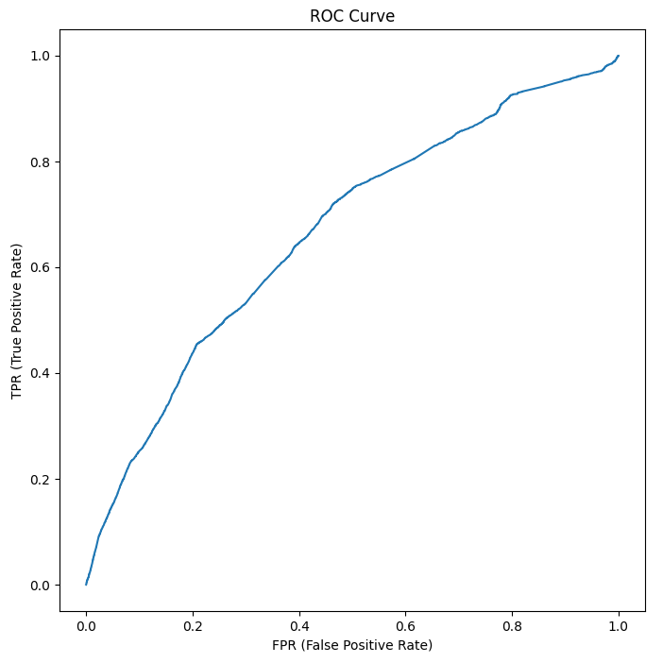
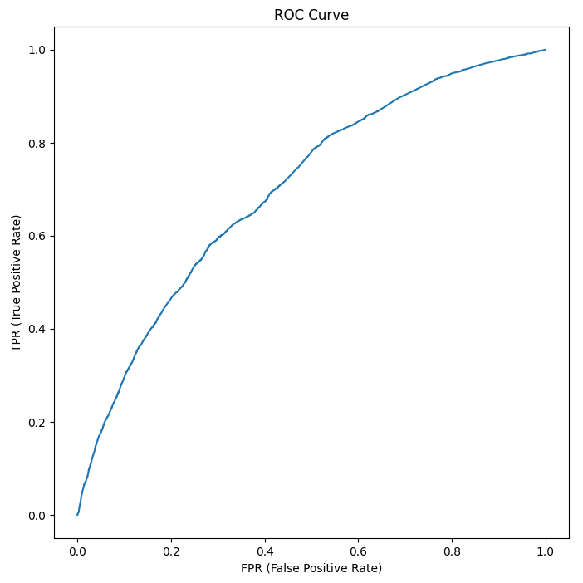

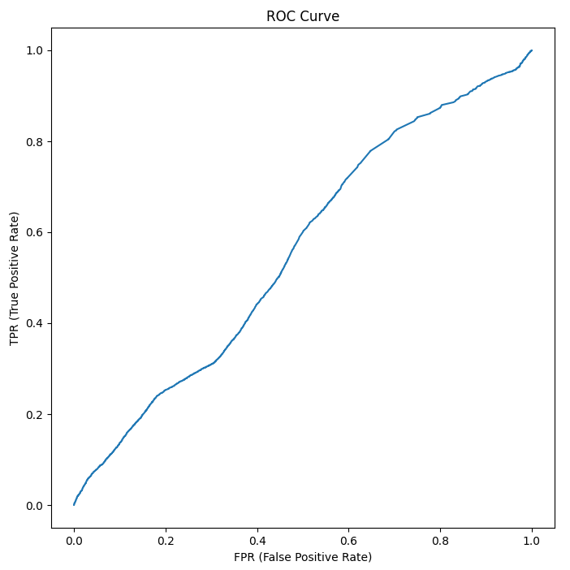

Correlation Based Feature Selection
F Score Feature Selection
Forward Sequential Feature Selection
Recursive Feature Selection
Select from Model Feature Selection

Slide 15
Decision Tree – SMOTE
Feature Selection | Class | Accuracy | TPR | FPR | Precision | Recall | F1 Score | MCC | ROC
Correlation based feature selection | Heart Attack = 1 | 0.327321673 | 0.305250414 | 0.694749586 | 0.948860002 | 0.305250414 | 0.400174037 | 0.004793428 | 0.504230474
 | Heart Attack = 2 | 0.327321673 | 0.703218762 | 0.296781238 | 0.054155784 | 0.703218762 | 0.099439713 | 0.004793428 | 0.504230474
 | Weighted | 0.327321673 | 0.327321673 | 0.672678327 | 0.899791389 | 0.327321673 | 0.383813658 | 0.004793428 | 0.504230474
F Score feature selection | Heart Attack = 1 | 0.429919534 | 0.427920142 | 0.572079858 | 0.930220056 | 0.427920142 | 0.57640923 | -0.050797608 | 0.446463024
 | Heart Attack = 2 | 0.429919534 | 0.465307847 | 0.534692153 | 0.045590604 | 0.465307847 | 0.082672478 | -0.050797608 | 0.446463024
 | Weighted | 0.429919534 | 0.429919534 | 0.570080466 | 0.881704639 | 0.429919534 | 0.549306752 | -0.050797608 | 0.446463024
Forward Sequential Feature Selection | Heart Attack = 1 | 0.528092499 | 0.533295031 | 0.466704969 | 0.937497783 | 0.533295031 | 0.658013549 | -0.015043831 | 0.486272887
 | Heart Attack = 2 | 0.528092499 | 0.439120875 | 0.560879125 | 0.054244103 | 0.439120875 | 0.09506401 | -0.015043831 | 0.486272887
 | Weighted | 0.528092499 | 0.528092499 | 0.471907501 | 0.889053806 | 0.528092499 | 0.627100404 | -0.015043831 | 0.486272887
Recursive Feature Elimination | Heart Attack = 1 | 0.451274658 | 0.443705899 | 0.556294101 | 0.933524525 | 0.443705899 | 0.561061427 | 0.006325978 | 0.514042861
 | Heart Attack = 2 | 0.451274658 | 0.583836127 | 0.416163873 | 0.059204522 | 0.583836127 | 0.106316954 | 0.006325978 | 0.514042861
 | Weighted | 0.451274658 | 0.451274658 | 0.548725342 | 0.885563456 | 0.451274658 | 0.53603736 | 0.006325978 | 0.514042861
Select from Model | Heart Attack = 1 | 0.463094485 | 0.45480204 | 0.54519796 | 0.951618537 | 0.45480204 | 0.593006675 | 0.030341864 | 0.53129727
 | Heart Attack = 2 | 0.463094485 | 0.607772787 | 0.392227213 | 0.063128287 | 0.607772787 | 0.113216569 | 0.030341864 | 0.53129727
 | Weighted | 0.463094485 | 0.463094485 | 0.536905515 | 0.902892084 | 0.463094485 | 0.56665121 | 0.030341864 | 0.53129727

Slide 16
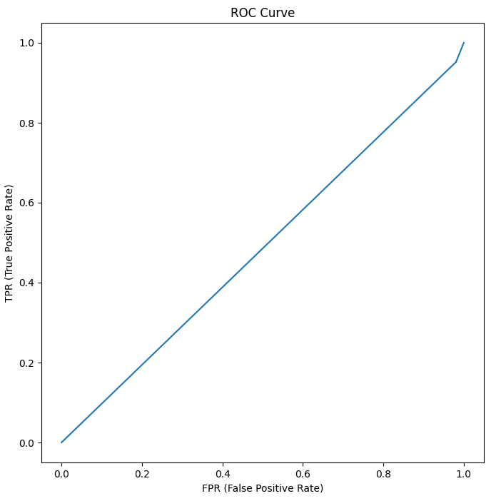
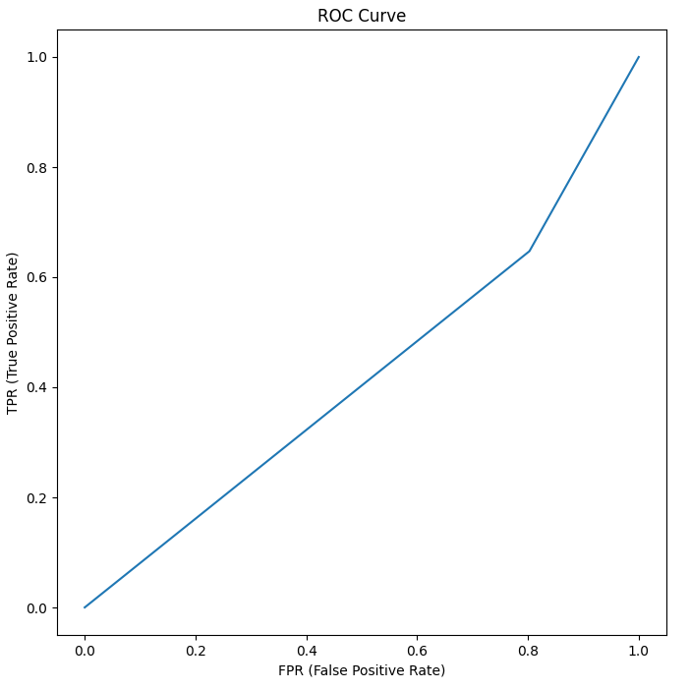
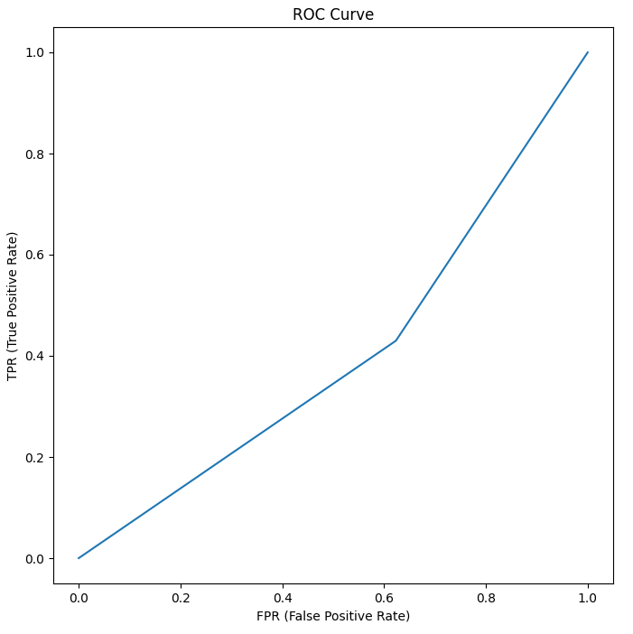

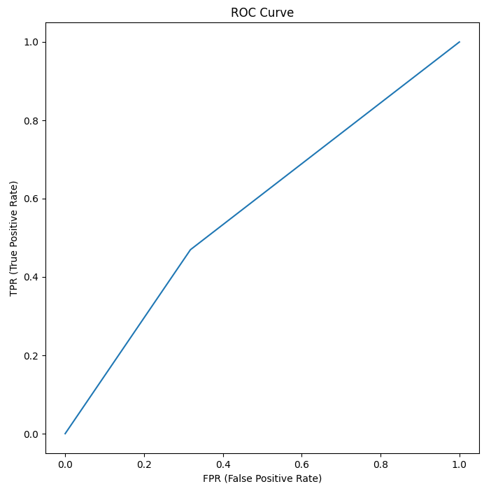
Correlation Based Feature Selection
F Score Feature Selection
Forward Sequential Feature Selection
Recursive Feature Selection
Select from Model Feature Selection

Slide 17
Logistic Regression – SMOTE
Feature Selection | Class | Accuracy | TPR | FPR | Precision | Recall | F1 Score | MCC | ROC
Correlation based feature selection | Heart Attack = 1 | 0.939925565 | 0.993660139 | 0.006339861 | 0.945552382 | 0.993660139 | 0.969006476 | 0.020211067 | 0.555098065
 | Heart Attack = 2 | 0.939925565 | 0.013902739 | 0.986097261 | 0.112105045 | 0.013902739 | 0.024199227 | 0.020211067 | 0.555098065
 | Weighted | 0.939925565 | 0.939925565 | 0.060074435 | 0.899846398 | 0.939925565 | 0.917188268 | 0.020211067 | 0.555098065
F Score feature selection | Heart Attack = 1 | 0.92568146 | 0.975048673 | 0.024951327 | 0.947818235 | 0.975048673 | 0.961240309 | 0.069293863 | 0.625568559
 | Heart Attack = 2 | 0.92568146 | 0.074835996 | 0.925164004 | 0.148487005 | 0.074835996 | 0.099468677 | 0.069293863 | 0.625568559
 | Weighted | 0.92568146 | 0.92568146 | 0.07431854 | 0.903982558 | 0.92568146 | 0.913981198 | 0.069293863 | 0.625568559
Forward Sequential Feature Selection | Heart Attack = 1 | 0.930821283 | 0.980358199 | 0.019641801 | 0.948203107 | 0.980358199 | 0.964010279 | 0.087814234 | 0.689557136
 | Heart Attack = 2 | 0.930821283 | 0.07699684 | 0.92300316 | 0.186903503 | 0.07699684 | 0.108602659 | 0.087814234 | 0.689557136
 | Weighted | 0.930821283 | 0.930821283 | 0.069178717 | 0.906449559 | 0.930821283 | 0.917102204 | 0.087814234 | 0.689557136
Recursive Feature Elimination | Heart Attack = 1 | 0.924169229 | 0.973034647 | 0.026965353 | 0.94809654 | 0.973034647 | 0.960392896 | 0.07304206 | 0.655215776
 | Heart Attack = 2 | 0.924169229 | 0.081769912 | 0.918230088 | 0.150837778 | 0.081769912 | 0.104565068 | 0.07304206 | 0.655215776
 | Weighted | 0.924169229 | 0.924169229 | 0.075830771 | 0.904372082 | 0.924169229 | 0.913468204 | 0.07304206 | 0.655215776
Select from Model | Heart Attack = 1 | 0.891469424 | 0.928317529 | 0.071682471 | 0.95563816 | 0.928317529 | 0.941629602 | 0.153130997 | 0.72649508
 | Heart Attack = 2 | 0.891469424 | 0.255907016 | 0.744092984 | 0.17385881 | 0.255907016 | 0.202943629 | 0.153130997 | 0.72649508
 | Weighted | 0.891469424 | 0.891469424 | 0.108530576 | 0.91276306 | 0.891469424 | 0.901130137 | 0.153130997 | 0.72649508

Slide 18
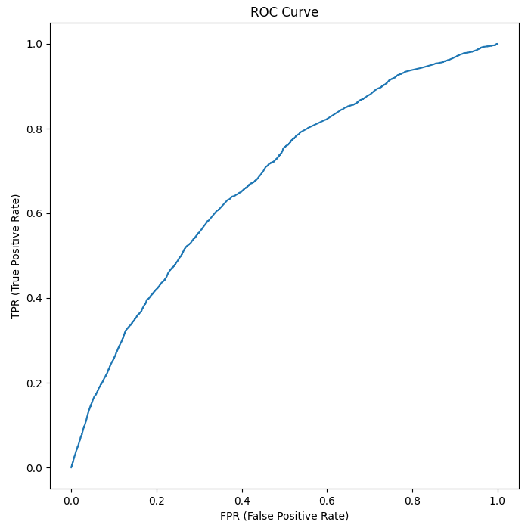


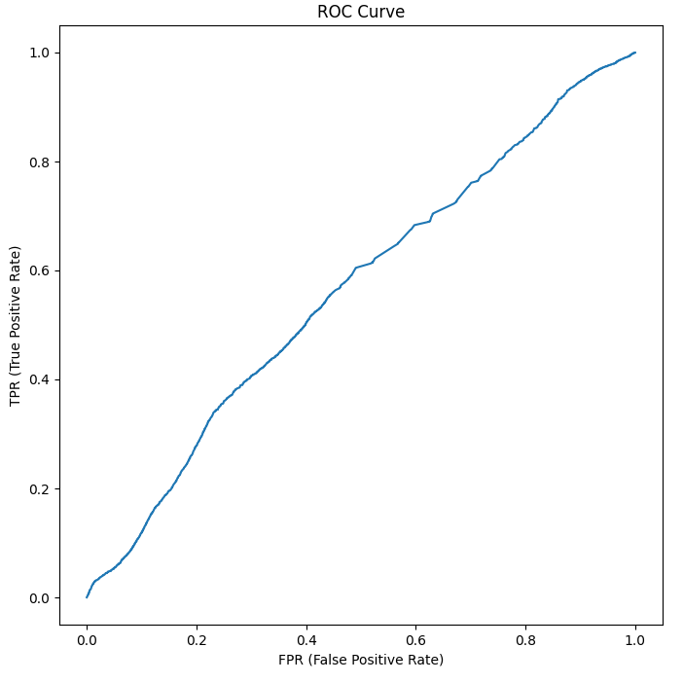
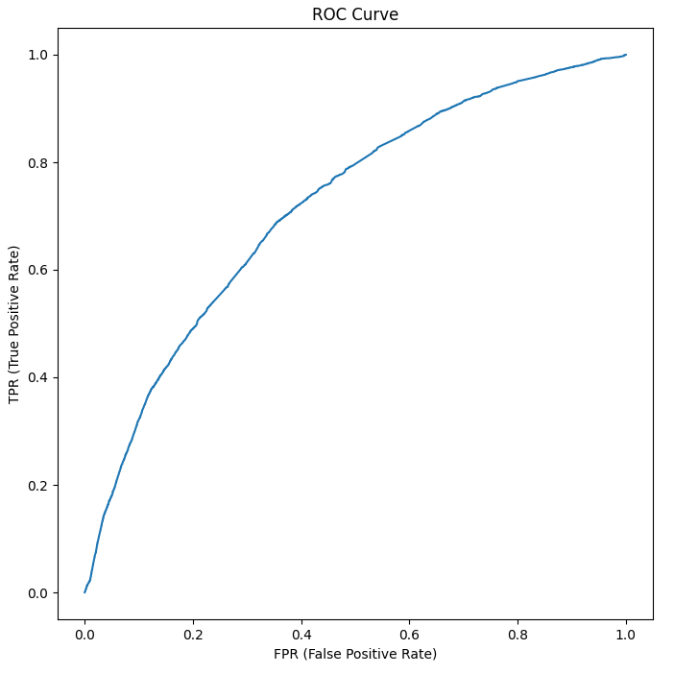
Correlation Based Feature Selection
F Score Feature Selection
Forward Sequential Feature Selection
Recursive Feature Selection
Select from Model Feature Selection

Slide 19
Gaussian Naïve Bayesian – SMOTE
Feature Selection | Class | Accuracy | TPR | FPR | Precision | Recall | F1 Score | MCC | ROC
Correlation based feature selection | Heart Attack = 1 | 0.593221436 | 0.597961847 | 0.402038153 | 0.955939566 | 0.597961847 | 0.698236374 | 0.059092199 | 0.588311161
 | Heart Attack = 2 | 0.593221436 | 0.508529906 | 0.491470094 | 0.076929565 | 0.508529906 | 0.127456164 | 0.059092199 | 0.588311161
 | Weighted | 0.593221436 | 0.593221436 | 0.406778564 | 0.907725877 | 0.593221436 | 0.667002642 | 0.059092199 | 0.588311161
F Score feature selection | Heart Attack = 1 | 0.850155195 | 0.89339052 | 0.10660948 | 0.945064536 | 0.89339052 | 0.918501163 | -0.001179156 | 0.501235911
 | Heart Attack = 2 | 0.850155195 | 0.105010211 | 0.894989789 | 0.05406605 | 0.105010211 | 0.071379539 | -0.001179156 | 0.501235911
 | Weighted | 0.850155195 | 0.850155195 | 0.149844805 | 0.896201432 | 0.850155195 | 0.872044426 | -0.001179156 | 0.501235911
Forward Sequential Feature Selection | Heart Attack = 1 | 0.934903426 | 0.988040617 | 0.011959383 | 0.945534841 | 0.988040617 | 0.966315006 | 0.014756836 | 0.589052123
 | Heart Attack = 2 | 0.934903426 | 0.019153443 | 0.980846557 | 0.086149322 | 0.019153443 | 0.030615629 | 0.014756836 | 0.589052123
 | Weighted | 0.934903426 | 0.934903426 | 0.065096574 | 0.898399865 | 0.934903426 | 0.914997838 | 0.014756836 | 0.589052123
Recursive Feature Elimination | Heart Attack = 1 | 0.87457303 | 0.920822836 | 0.079177164 | 0.945052032 | 0.920822836 | 0.932763005 | -0.001346887 | 0.584556073
 | Heart Attack = 2 | 0.87457303 | 0.077359496 | 0.922640504 | 0.053979697 | 0.077359496 | 0.063410847 | -0.001346887 | 0.584556073
 | Weighted | 0.87457303 | 0.87457303 | 0.12542697 | 0.896183985 | 0.87457303 | 0.885089343 | -0.001346887 | 0.584556073
Select from Model | Heart Attack = 1 | 0.87457303 | 0.920822836 | 0.079177164 | 0.945052032 | 0.920822836 | 0.932763005 | -0.001346887 | 0.584556073
 | Heart Attack = 2 | 0.87457303 | 0.077359496 | 0.922640504 | 0.053979697 | 0.077359496 | 0.063410847 | -0.001346887 | 0.584556073
 | Weighted | 0.87457303 | 0.87457303 | 0.12542697 | 0.896183985 | 0.87457303 | 0.885089343 | -0.001346887 | 0.584556073

Slide 20
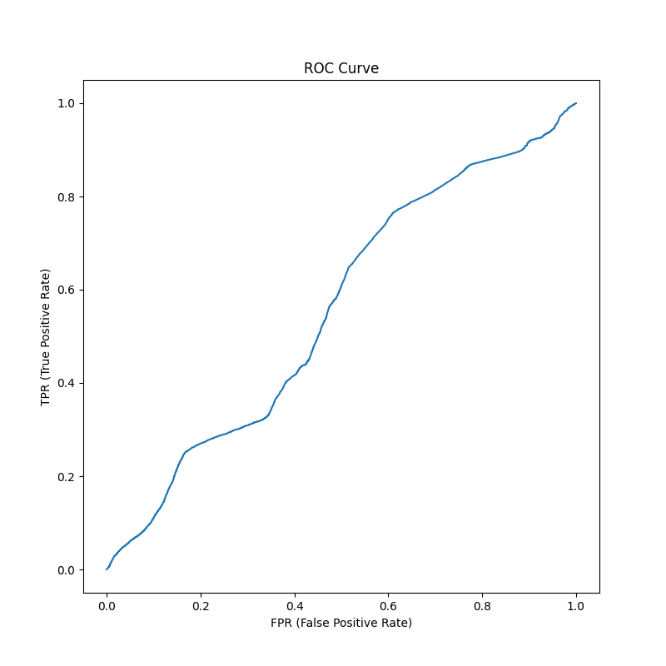

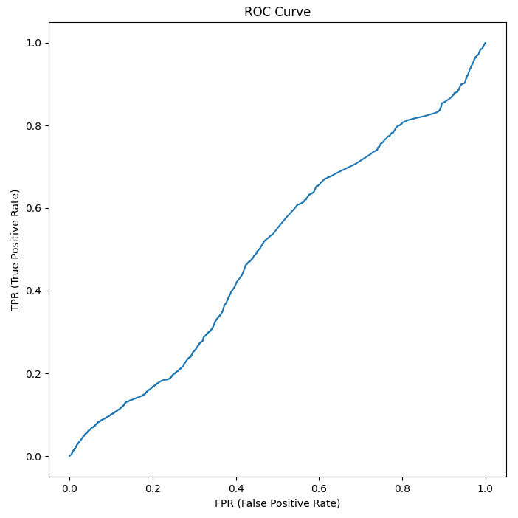
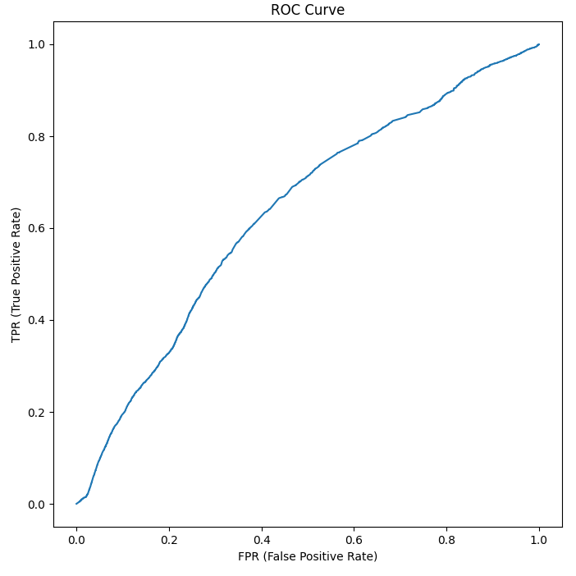
Correlation Based Feature Selection
F Score Feature Selection
Forward Sequential Feature Selection
Recursive Feature Selection
Select from Model Feature Selection

Slide 21
Random Forest – SMOTE
Feature Selection | Class | Accuracy | TPR | FPR | Precision | Recall | F1 Score | MCC | ROC
Correlation based feature selection | Heart Attack = 1 | 0.49936451 | 0.498902735 | 0.501097265 | 0.944821975 | 0.498902735 | 0.643547883 | 0.004891152 | 0.502739416
 | Heart Attack = 2 | 0.49936451 | 0.507213641 | 0.492786359 | 0.058497443 | 0.507213641 | 0.103590408 | 0.004891152 | 0.502739416
 | Weighted | 0.49936451 | 0.49936451 | 0.50063549 | 0.89621531 | 0.49936451 | 0.613947283 | 0.004891152 | 0.502739416
F Score feature selection | Heart Attack = 1 | 0.727112785 | 0.757211373 | 0.242788627 | 0.942079646 | 0.757211373 | 0.830697443 | -0.016554567 | 0.478281542
 | Heart Attack = 2 | 0.727112785 | 0.20786423 | 0.79213577 | 0.050379653 | 0.20786423 | 0.075889555 | -0.016554567 | 0.478281542
 | Weighted | 0.727112785 | 0.727112785 | 0.272887215 | 0.893183917 | 0.727112785 | 0.78931956 | -0.016554567 | 0.478281542
Forward Sequential Feature Selection | Heart Attack = 1 | 0.7371806 | 0.76359033 | 0.23640967 | 0.94923014 | 0.76359033 | 0.835047959 | 0.025591626 | 0.543785335
 | Heart Attack = 2 | 0.7371806 | 0.280669931 | 0.719330069 | 0.066402759 | 0.280669931 | 0.10044698 | 0.025591626 | 0.543785335
 | Weighted | 0.7371806 | 0.7371806 | 0.2628194 | 0.90082409 | 0.7371806 | 0.794793721 | 0.025591626 | 0.543785335
Recursive Feature Elimination | Heart Attack = 1 | 0.559458068 | 0.565114091 | 0.434885909 | 0.937900204 | 0.565114091 | 0.647639433 | 0.012350493 | 0.541127136
 | Heart Attack = 2 | 0.559458068 | 0.467077242 | 0.532922758 | 0.060961525 | 0.467077242 | 0.103535007 | 0.012350493 | 0.541127136
 | Weighted | 0.559458068 | 0.559458068 | 0.440541932 | 0.889799699 | 0.559458068 | 0.61764464 | 0.012350493 | 0.541127136
Select from Model | Heart Attack = 1 | 0.740769944 | 0.763996558 | 0.236003442 | 0.952375335 | 0.763996558 | 0.847600244 | 0.054819755 | 0.586494884
 | Heart Attack = 2 | 0.740769944 | 0.340011244 | 0.659988756 | 0.076554944 | 0.340011244 | 0.124782534 | 0.054819755 | 0.586494884
 | Weighted | 0.740769944 | 0.740769944 | 0.259230056 | 0.904343254 | 0.740769944 | 0.807967736 | 0.054819755 | 0.586494884

Slide 22
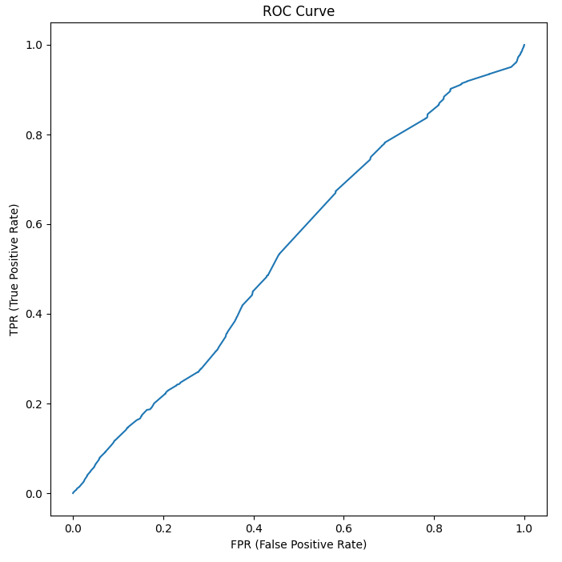
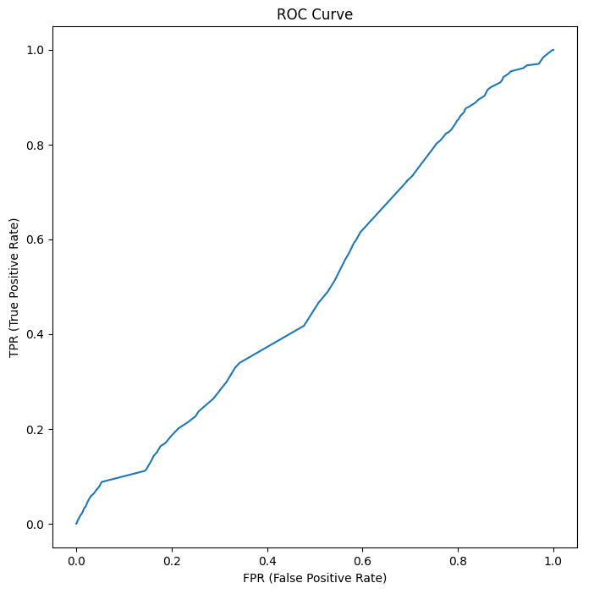
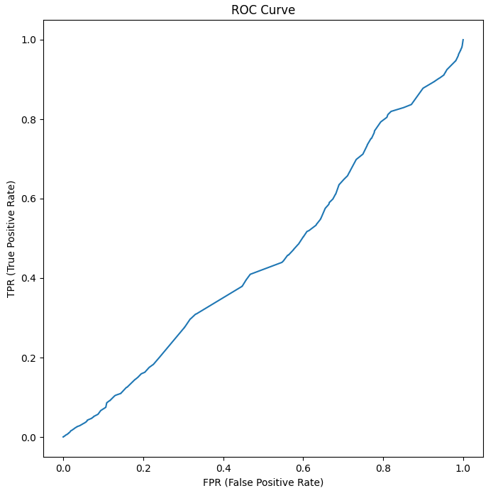
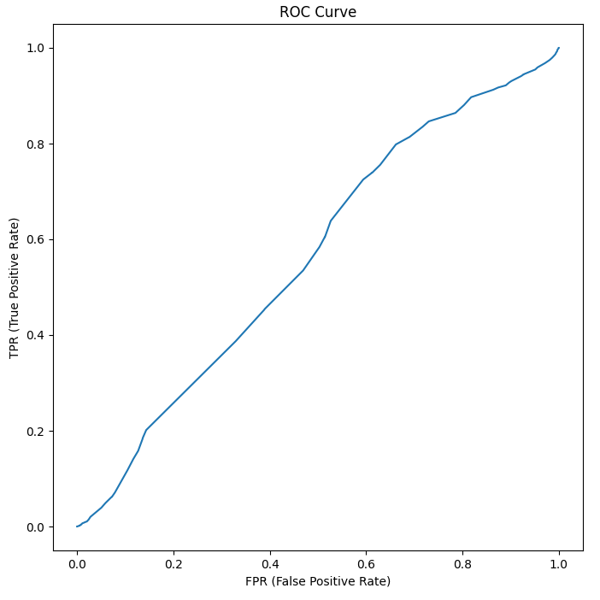
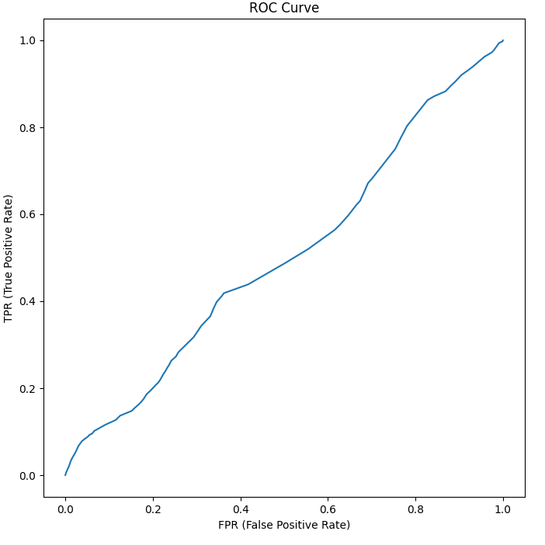
Correlation Based Feature Selection
F Score Feature Selection
Forward Sequential Feature Selection
Recursive Feature Selection
Select from Model Feature Selection

Slide 23
Best Model – SMOTE
Classifier | Feature Selection | Class | Accuracy | TPR | FPR | Precision | Recall | F1 Score | MCC | ROC
Ada Boost | Select from Model | Heart Attack = 1 | 0.915259124 | 0.961845377 | 0.038154623 | 0.949270616 | 0.961845377 | 0.955267138 | 0.076989577 | 0.702672513
 |  | Heart Attack = 2 | 0.915259124 | 0.112024146 | 0.887975854 | 0.141530531 | 0.112024146 | 0.109501674 | 0.076989577 | 0.702672513
 |  | Weighted | 0.915259124 | 0.915259124 | 0.084740876 | 0.904972904 | 0.915259124 | 0.908893848 | 0.076989577 | 0.702672513
Decision Tree | Select from Model | Heart Attack = 1 | 0.463094485 | 0.45480204 | 0.54519796 | 0.951618537 | 0.45480204 | 0.593006675 | 0.030341864 | 0.53129727
 |  | Heart Attack = 2 | 0.463094485 | 0.607772787 | 0.392227213 | 0.063128287 | 0.607772787 | 0.113216569 | 0.030341864 | 0.53129727
 |  | Weighted | 0.463094485 | 0.463094485 | 0.536905515 | 0.902892084 | 0.463094485 | 0.56665121 | 0.030341864 | 0.53129727
Logistic Regression | Select from Model | Heart Attack = 1 | 0.891469424 | 0.928317529 | 0.071682471 | 0.95563816 | 0.928317529 | 0.941629602 | 0.153130997 | 0.72649508
 |  | Heart Attack = 2 | 0.891469424 | 0.255907016 | 0.744092984 | 0.17385881 | 0.255907016 | 0.202943629 | 0.153130997 | 0.72649508
 |  | Weighted | 0.891469424 | 0.891469424 | 0.108530576 | 0.91276306 | 0.891469424 | 0.901130137 | 0.153130997 | 0.72649508
Gaussian Naïve Bayesian | Forward Sequential Feature Selection | Heart Attack = 1 | 0.934903426 | 0.988040617 | 0.011959383 | 0.945534841 | 0.988040617 | 0.966315006 | 0.014756836 | 0.589052123
 |  | Heart Attack = 2 | 0.934903426 | 0.019153443 | 0.980846557 | 0.086149322 | 0.019153443 | 0.030615629 | 0.014756836 | 0.589052123
 |  | Weighted | 0.934903426 | 0.934903426 | 0.065096574 | 0.898399865 | 0.934903426 | 0.914997838 | 0.014756836 | 0.589052123
Random Forest | Select from Model | Heart Attack = 1 | 0.740769944 | 0.763996558 | 0.236003442 | 0.952375335 | 0.763996558 | 0.847600244 | 0.054819755 | 0.586494884
 |  | Heart Attack = 2 | 0.740769944 | 0.340011244 | 0.659988756 | 0.076554944 | 0.340011244 | 0.124782534 | 0.054819755 | 0.586494884
 |  | Weighted | 0.740769944 | 0.740769944 | 0.259230056 | 0.904343254 | 0.740769944 | 0.807967736 | 0.054819755 | 0.586494884

Slide 24
Conclusion
Data Preparation
Data Set Balancing
Feature Selection
Classification
Different methods give different results.

